Slide 1
Annual Meeting Prairie Fields Homeowners Association
JANUARY 24, 2019
SETH YODER – PRESIDENT, PFHOA

Slide 2
Agenda
8:00 Call to Order
8:01 Welcome, Agenda, & Meeting Ground Rules
8:05 What is an HOA?
8:10 Board of Directors
8:12 What are covenants?
8:20 How your dues are spent
8:30 HOA committees
8:40 Current HOA Issues and Updates
9:00 Open Questions & Answers

Slide 3
Meeting Ground Rules
Safety is key
Please sign in
Know exits and emergency procedures
Please silence your cell phone
We respect your time
We will keep the meeting schedule on-time
We will hold all questions at the end

Slide 4
What is an HOA?
Maintain and enhance property values through enforcing the covenants and maintenance of common areas
Non-profit corporation
All owners of lots in the Prairie Fields Subdivision are members
Bylaws describe how the HOA will run
Board of Directors manage the business and affairs of the Association

Slide 5
Board of Directors
Directors are elected by HOA members
Directors are Volunteers
Duties include:
Care and upkeep of common areas
Collect annual assessments
Provide a budget
Secure insurance
Act to better the subdivision
Enforce covenants

Slide 6
Board of Directors
Directors are elected by HOA members
Volunteers
Duties include:
Care and upkeep of common areas
Collect annual assessments
Provide a budget
Secure insurance
Act to better the subdivision
Enforce covenants*

Slide 7
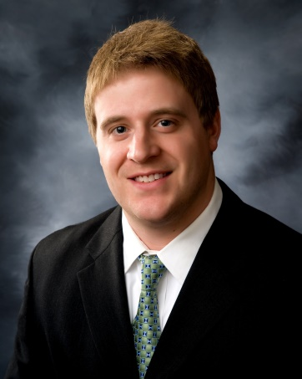
Board of Directors
Seth Yoder President | PJ Patterson Vice President | Erik Olson Treasurer | Kolby Jackson Secretary
Raji Nair Board Member | Mia Hernandez Board Member | Brian Kesler Board Member

Slide 8
What are covenants?
Guidelines for the community prepared by developer
Contract you signed when you purchased your home
Act to preserve property values
These guidelines control:
tree plantings signs
grass height garbage
parking livestock
landscaping fences
storage decks
hazardous waste sheds
roof maintenance satellite dishes…

Slide 9
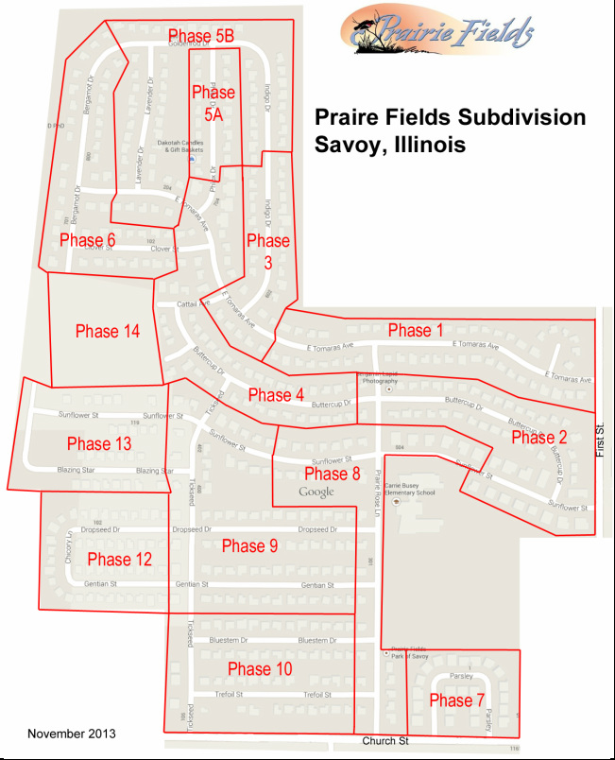
Each of the 13 phases has its own (differing) covenants…
This leads to non-uniformity

Slide 10
Architectural Control Committee (ACC)
Seth Yoder
Brian Kesler
PJ Patterson
Review proposed architectural plans and grant approval to proceed based on covenants

Slide 11
Your dues
INCOME, EXPENSES AND BUDGET

Slide 12
Your dues: Revenue
 | 2016 | 2017 | Budget for 2018 | 2018 | Budget for 2019
Annual Assessment | 64,500 | 64,942 | 64,500 | 64,942 | 64,500
Write Off of Uncollectible Dues | 0 | 0 | 0 | 0 | 0
Closing letter fees | 735 | 750 | 750 | 690 | 750
Paypal and Other Fees | 131 | 176 | 130 | 118 | 130
Interest on unpaid dues | 2370 | 2989 | 2300 | 3242 | 2300
Bank Interest | 89 | 91 | 100 | 91 | 100
Special Assessments and Grants | 250 | 0 | 0 | 0 | 0
Rebilled Legal Expenses | 828 | 0 | 0 | 0 | 0
Total Revenue | $ 68,943 | $68,491 | $67,780 | $69,083 | $67,780

Slide 13
 | 2017
Capital Improvements | 2000
Common Area Maintenance | 13612
Utilities | 2807
Insurance and Bond | 2350
Taxes | 18
Banking Fees | 174
Misc. Operating Expenses | 254
Communications | 312
Annual Meeting | 82
Election | 0
Neighborhood Events | 9673
Welcoming | 0
Accounting Fees | 3239
Legal Fees | 156
Architectural Control | 0
Total Costs | $34,678
Budget for 2018 | 2018 | Over (Under)
10,000 | 0 | (10,000)
16,000 | 15,571 | (397)
2000 | 2,378 | 378
2,300 | 2,359 | 59
20 | 21 | 1
200 | 76 | (124)
300 | 546 | 246
700 | 1,162 | 462
125 | 0 | (125)
0 | 0 | 0
13,000 | 74 | (12,026)
0 | 0 | 0
3,300 | 3,294 | (6)
1,200 | 1,685 | 485
500 | 0 | (82)
$49,645 | $27,166 | ($9,141)
Budget for 2019
5,000
16,000
2,500
2,400
15
200
600
1200
125
0
5,000
0
3,300
1,200
500
$37,940
Your dues: Expenses

Slide 14
Your dues: Net Income & Equity
 | 2016 | 2017 | Budget 2018 | 2018 | Budget 2019
Net Income to Reserves | $37,315 | $34,408 | $18,135 | $44,723 | $29,840
 | 2016 | 2017 | 2018
Total Equity | $238,086 | $271,768 | $316,535

Slide 15
HOA Committees

Slide 16
HOA Committees
Enhancing your community
Facilitating community interaction
Celebrating cultural diversity
Increasing safety
Enhancing communications
Improving awareness of local businesses and services
Communications Committee
Events Committee
Welcoming Committee
10

Slide 17
Communications Committee
Website
Newsletter Emails
Website
Facebook Page
Postcards

Slide 18
Pay Dues Online
Coming Soon:
HOA Portal
Easy Payment System
Electronic Statements
New website features
Easy Communication features

Slide 19
Community Forum
Many of your neighbors in Prairie Fields use Nextdoor.com to share information including
Events
Road closures
Lost pets
Babysitting services
Items for sale
Crime and safety updates
It is the private social network.

Slide 20
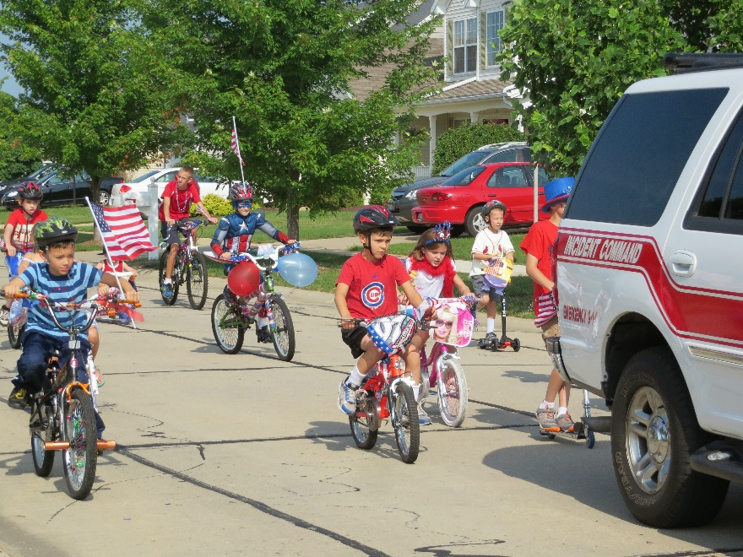
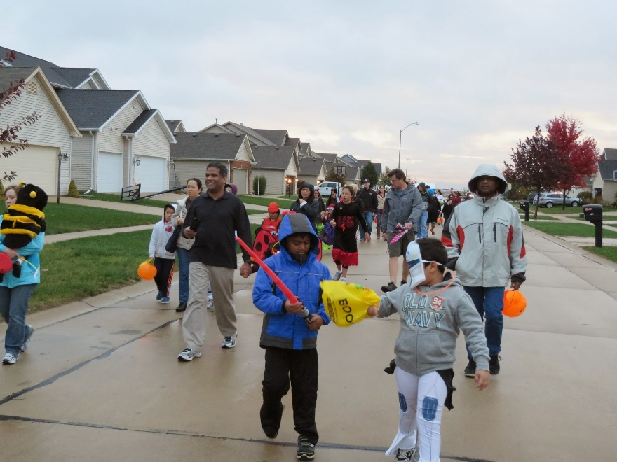
Events Committee
Block Party Grants
International Potluck
Prairie Fields Garage Sale (June)
Prairie Fields Neighborhood Picnic (June)
July 4th Parade (July)
Halloween Parade (October)
Diwali Celebration (October or November)
Holiday Light Contest (December)
Chinese New Year, Eid ul-Fitr, others?

Slide 21
Welcoming Committee
Contacting new residents of Prairie Fields via email to provide information about Prairie Fields

Slide 22
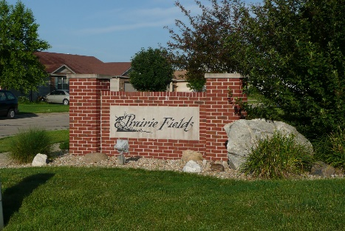
HOA Issues and Updates
Finding members to support events
New HOA portal
Common area improvements & upkeep
Continue assessing liens on delinquent members

Slide 23
Most common covenant violations
Vehicles parked on the street for extended periods
Structures erected without HOA ACC approval
Garbage canisters not stored out of sight
Grass height and weeds
Delinquent dues

Slide 24
Neighborhood Safety
Neighborhood Watch
Signs are up!
Communication: e-mail list, Nextdoor, Facebook
If you see something suspicious, contact the police THEN spread the word to neighbors.

Slide 25
Questions & Answers

